Slide 1

QLD Housing Vacancy
PROJECT 1

Slide 2
Eligibility for Housing
1. Australian citizenship and residency status
2. Queensland residency
3. No Property ownership
4. Liquid asset test (Single – under $117k and 2 or more under $149k)
5. Independent Income ( $226.81 per week with proof of min 4 weeks)
6. Household income must fall below $609 to $1121 per week ( depending on family size)
7. Wellbeing
→ https://www.qld.gov.au/housing/public-community-housing/eligibility-applying-for-housing/eligibility-for-housing/check-your-eligibility

Slide 3
Types of Housing
Detached house
A house with 2 or more bedrooms on 1 block of land.
Duplex
Usually 2 units, with 1–3 bedrooms in each, divided by a common wall, located on 1 block of land.
Dual occupancy
2 properties located on one block of land.
Cluster house
A number of attached or separate homes, with 2–4 bedrooms in each, located within a housing development.
Townhouse
3 or more units next to each other, with 1–4 bedrooms in each, divided by common walls.
Apartment / flat / unit
Usually a complex of 2 or more storeys, with 1–3 bedrooms in each.
Seniors’ unit
For people over the age of 55, usually in a complex of 1–2 storeys, with 1–2 bedrooms in each.
→ https://www.qld.gov.au/housing/public-community-housing/eligibility-applying-for-housing/eligibility-for-housing/types-of-houses-provided

Slide 4
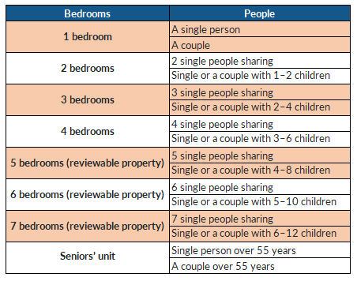
Bedroom entitlements
The number of bedrooms in the property
listed on the housing register
for is based on:
Number of people within your household
Gender of the people in your household
Age of the people in your household.
https://www.qld.gov.au/housing/public-community-housing/eligibility-applying-for-housing/eligibility-for-housing/types-of-houses-provided

Slide 5
Project Objectives
(1) How vacancy rate changes over the year?
(2) How dwelling type effect Vacancy rates?
(3) How Vacancy rate effected by Geography?
(4) How vacancy rate varied by social housing program?
(5) Were vacancy days Tenantable or Untenantable?

Slide 6
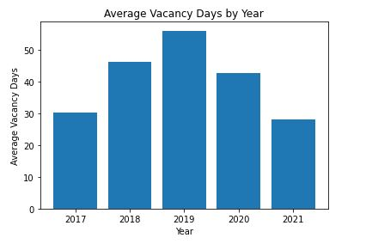
Average Vacancy Days by Year

Slide 7
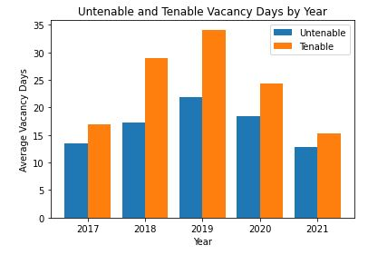
Untenable and Tenable Vacancy Days by Year

Slide 8
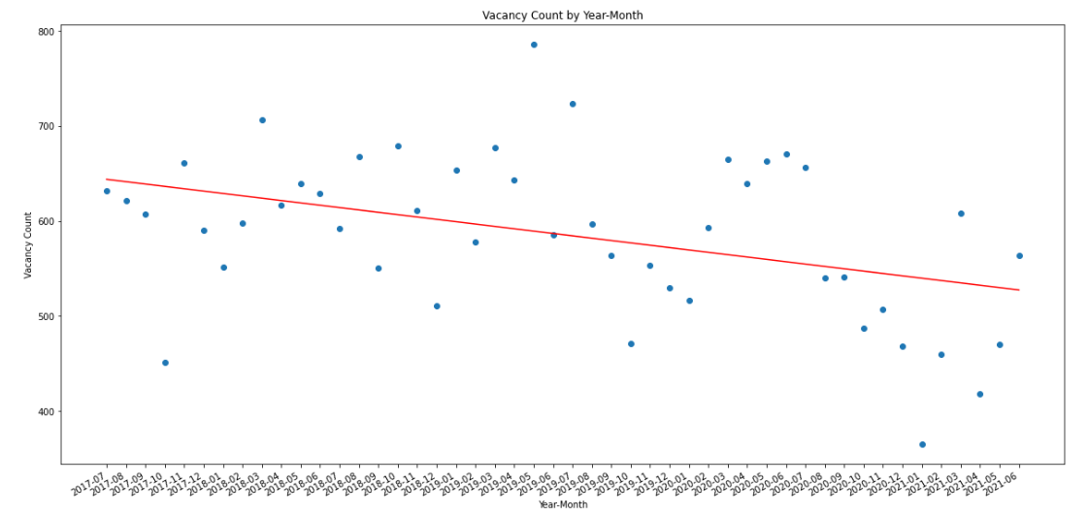
Vacancy Count by Year-Month

Slide 9
Affects of Housing from Covid

Slide 10
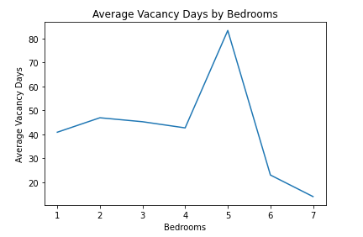
Average Vacancy Days by Bedrooms

Slide 11
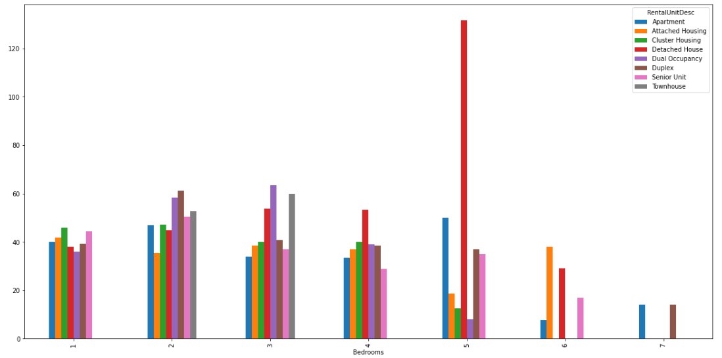
Housing types and bedroom comparison

Slide 12
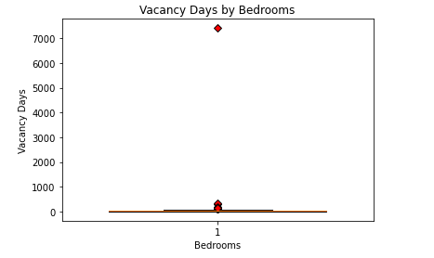
Outliers of vacancy days against bedrooms

Slide 13
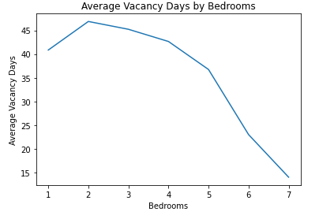
Average Vacancy Days against bedrooms

Slide 14
Qld Housing Vacancy – Data Limitations
1 | 2 | 3 | 4

Slide 15
Discussion on Results

Slide 16
Conclusion

